Slide 1
Implementing Security
Dr Govindha Ramaiah Yeluripati

Slide 2
Outline
PART1: Security Essentials:
  Introduction to Web Security
  Common Web Vulnerabilities
  Security Best Practices
  OWASP Top 10 and Defense-in-Depth
  Conclusion and Key Takeaways
PART2: Implementing user Authentication

Slide 3
Security Essentials

Slide 4
Introduction to Web Security
What is Web Security?:
  Protecting websites, web applications, and their users from cyber threats
Importance of Web Security:
  The risks of data breaches
  loss of trust, and
  legal implications
Threat Landscape:
  Attackers target both users and applications
Notes:
Web security refers to the measures and practices used to protect websites, web applications, and users from cyber threats. It encompasses a variety of tools, practices, and security protocols.
Some examples of threats to Web applications include unauthorized access to sensitive data, exploitation of vulnerabilities in web applications (e.g., SQL injection, XSS), and attacks like Distributed Denial of Service (DDoS). The goal of Web security is to ensure the confidentiality, integrity, and availability of data and services.
Unauthorized access can lead to the theft of sensitive information such as financial details, personal identities, or trade secrets. Several incidents (any latest?) are being reported every day leading to data breaches and significant financial losses.
A breach or attack can erode the trust customers or users place in an organization. Trust is critical for brand reputation and customer retention. For example, a compromised e-commerce platform might lose customers unwilling to risk their data.
There are several regulatory and compliance requirements (e.g., GDPR, HIPAA, or CCPA) that mandate organizations to safeguard user data. Failing to comply with these requirements can result in hefty fines, legal actions, or business shutdowns.
Phishing attacks or malware often aim to deceive users into providing sensitive information or compromising their devices. You can think about a fake website or emails requesting login credentials.
Several types of attacks target vulnerabilities in web applications like SQL Injection: Injecting malicious code to exploit database vulnerabilities. Cross-Site Scripting (XSS): Injecting malicious scripts into websites to target users. DDoS Attacks: Overloading a server to make the website/application unavailable. So, as applications grow complex, they become attractive targets.

Slide 5
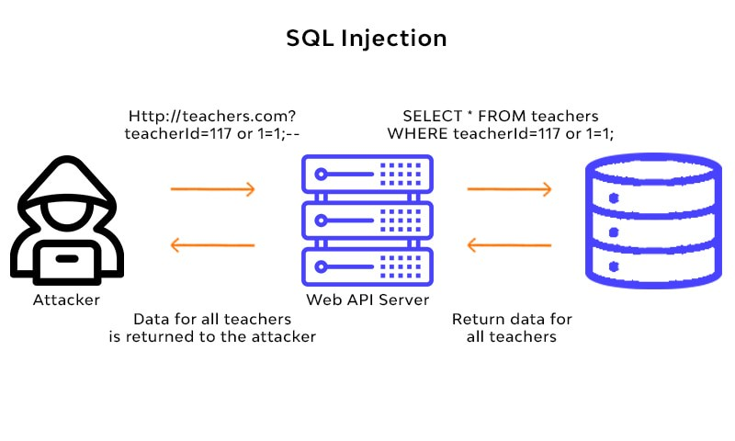
Common Web Vulnerabilities
SQL Injection (SQLi): Injection of malicious SQL queries
Cross-Site Scripting (XSS): Injection of malicious scripts into a web page
Cross-Site Request Forgery (CSRF): Unauthorized actions executed by a user’s browser
Insecure Authentication: Weak passwords, session hijacking, improper credential storage
Broken Access Control: Failure to restrict users' access to specific data or actions
Notes:
Web vulnerabilities are weaknesses in web applications that attackers exploit to compromise the confidentiality, integrity, or availability of systems or data. Therefore, understanding these vulnerabilities is key to preventing them.
SQL Injection is a type of attack where an attacker manipulates a web application's database query by injecting malicious SQL code. For example, as shown in the diagram, the attacker sends a specially crafted input like teacherId=117 OR 1=1, which tricks the database into executing unintended queries. The query SELECT * FROM teachers WHERE teacherId=117 OR 1=1 always evaluates to true, exposing all data in the teachers table. This can lead to data breaches, unauthorized data modification, or even complete system compromise. To prevent this kind of attack, the developers should use prepared statements, parameterized queries, and input validation.
XSS is an attack where attackers inject malicious scripts (usually JavaScript) into web pages that are then executed in the browsers of unsuspecting users. But, how does this work? Attackers exploit vulnerabilities in how the application handles user input. The malicious script might steal cookies, redirect users to malicious sites, or deface the website. For example, a compromised login page could steal credentials from users. To prevent this attack, we must use output encoding, sanitize user inputs, and implement a Content Security Policy (CSP).
CSRF tricks a user’s browser into performing actions they didn’t intend while authenticated, like transferring funds or changing account details. Consider the example that if a user is logged into their bank account, a malicious site can send a request that transfers money without their consent. To prevent such attacks, we must use anti-CSRF tokens, validate HTTP requests, and implement same-site cookies.
Insecure Authentication vulnerability involves weak mechanisms for verifying users, like allowing weak passwords, session hijacking due to poorly secured session tokens, and improper credential storage such as storing passwords in plaintext. This may lead to unauthorized access, identity theft, and loss of sensitive data. To prevent such attacks we must enforce strong password policies, use HTTPS, secure session management, and store passwords using strong hashing algorithms like bcrypt.
Broken Access Control occurs when an application does not properly enforce user permissions, allowing unauthorized users to access or modify restricted data or actions. As a result, for example, an unauthorized user might access admin-only functionality or data by directly entering a URL they shouldn’t have access to. To prevent these attacks we must implement proper role-based access controls (RBAC), validate access permissions for every request, and avoid relying solely on client-side authorization.
So, proactively addressing these vulnerabilities to secure web applications and protect users is very important. As a developer you might think of adopting secure coding practices, regular vulnerability scanning, and security testing.

Slide 6
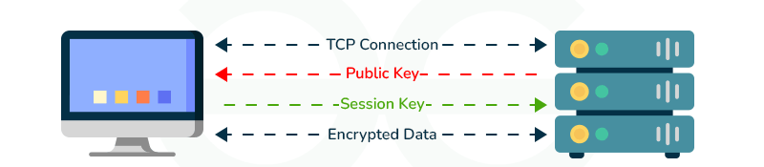
Security Best Practices
Input Validation: Sanitizing and validating user input to prevent injection attacks
Authentication & Authorization: Using strong password policies, multi-factor authentication (MFA), and implementing proper role-based access control
Secure Session Management: Proper session handling, avoiding session IDs in URLs, and using secure cookies.
Encryption: Implementing HTTPS/TLS to secure data in transit, using encryption for sensitive data at rest.
HTTPS
Notes:
There are several measures and proactive steps to safeguard systems and data.
Input validation ensures that user inputs say for example form inputs, are sanitized and validated to prevent malicious data from being processed by the system. This can prevent SQL injection, Cross-Site Scripting (XSS), or other injection attacks. It is recommended to use server-side validation to enforce stricter controls on data input avoiding directly trusting client-side validations. Implement whitelists for acceptable input formats (e.g., ensuring only numeric inputs for age fields).
Authentication is the process where the identity of users is verified. You must use strong password policies (e.g., minimum length, a combination of characters). Implement multi-factor authentication (MFA) to add an extra layer of security.
Authorization ensures users have the necessary permissions to access specific resources. One commonly used method is to enforce role-based access control (RBAC) to define permissions based on user roles
Remember that, both authentication and authorization work together to ensure secure access to applications.
Properly managing user sessions is essential to prevent session hijacking and unauthorized access. Avoid exposing session IDs in URLs as they can be easily intercepted. Use secure cookies with attributes like HttpOnly and Secure. Implement session timeouts to reduce the risk of session fixation or theft. Remember that, poor session handling can allow attackers to impersonate legitimate users.
Encryption protects sensitive data both during transmission (in transit) and while it is stored (at rest).
The diagram explains how HTTPS encrypts data using SSL/TLS protocols.
The public key encrypts the data, and the session key ensures secure communication between the browser and the server.
Always enforce HTTPS for secure communication. Use strong encryption algorithms like AES for sensitive data storage. Avoid using outdated protocols like SSLv2 or weak algorithms. Remember that, encryption ensures confidentiality, prevents eavesdropping, and protects data integrity.

Slide 7
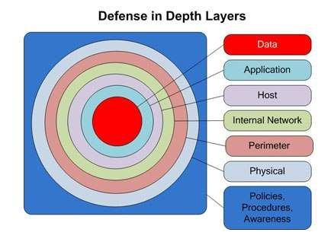
OWASP Top 10 and Defense-in-Depth
OWASP Top 10 web security vulnerabilities
(SQLi, XSS, CSRF, etc.)
Defense-in-Depth Strategy: Apply multiple layers of defense at different levels of the system (network, application, and data).
Notes:
OWASP (Open Web Application Security Project) is a nonprofit organization that provides resources to help organizations improve the security of their web applications. The OWASP Top 10 is a widely recognized list of the most critical web application security risks. It serves as a guideline for developers and organizations to prioritize and mitigate these risks. Understanding and mitigating these vulnerabilities significantly reduces the risk of cyberattacks.
Defense-in-depth is a cybersecurity strategy that applies multiple layers of defense to protect systems, applications, and data.
The layers of defense range from physical security (outermost) to application and data protection (innermost).
Each layer acts as a barrier, slowing down attackers and increasing the chances of detecting and stopping them.
The Key Layers include:
Physical Security: Securing physical access to servers and hardware.
Perimeter Security: Firewalls, intrusion detection systems (IDS), and intrusion prevention systems (IPS).
Internal Network Security: Securing internal communications and network segmentation.
Host Security: Hardening servers and workstations.
Application Security: Preventing vulnerabilities like SQLi, XSS, and CSRF through secure coding practices.
Data Security: Encrypting sensitive data both at rest and in transit.
Understand that no single defense mechanism is foolproof. Combining multiple defenses increases overall security.

Slide 8
Conclusion and Key Takeaways
Summary of Best Practices:
  Input validation, encryption, authentication
Tools and Resources:
  Penetration testing (e.g., OWASP ZAP, Burp Suite)
  Automated security testing tools
Final Thoughts:
  Ongoing nature of web security
  Regular updates
  Staying informed on security vulnerabilities
Notes:
Summary of Best Practices
Sanitizing and validating user inputs to prevent injection attacks and other exploits is crucial.
HTTPS/TLS plays a significant role in protecting data during transit and strong encryption methods for data at rest.
Strong authentication mechanisms, including multi-factor authentication (MFA), is the key to secure user access.
Tools and Resources
OWASP ZAP is a free and popular tool for finding vulnerabilities in web applications.
Also, Burp Suite has robust features for analyzing and testing web application security.
There are several Automated Security Testing Tools that you might want to integrate into the development lifecycle to identify and address issues early (e.g., static code analysis tools or CI/CD security scanners).
All such tools help supplement manual efforts and improve efficiency in detecting vulnerabilities.
Final Thoughts
Web security is not a one-time activity. It requires continuous monitoring, testing, and updating to stay ahead of evolving threats.
It is very important to keep software, frameworks, and libraries updated to patch vulnerabilities. Outdated systems are a common entry point for attackers.
It is highly recommended to stay updated on new vulnerabilities and attack techniques by following platforms like OWASP and security forums.
Fostering a culture of security awareness among developers and stakeholders is crucial.

Slide 9
References and Further Reading
moz://a
Mozilla Developer Network (MDN) Web Docs
Google's Web Security
Notes:
moz://a is Mozilla’s initiative to promote secure and privacy-respecting web development.
Explore Mozilla's guidelines and tools, such as Security best practices for developers and Firefox-specific security features and their implementation.
MDN Web Docs is a comprehensive resource for web developers. It provides detailed tutorials on secure web development, best practices for handling user input, cookies, HTTPS, and more. For example, search for "secure cookies" or "input sanitization" on MDN for in-depth guidance.
Google provides tools and documentation focused on securing web applications and improving user safety online. Google’s Safe Browsing initiative, for example, protects users from malicious websites.
Also, provides guidelines for developers on integrating Google’s security services.
Please explore their recommendations for HTTPS and Content Security Policies (CSP).

Slide 10
Implementing User Authentication

Slide 11
Steps for our Example Application
Add User Authentication Endpoints:
  Add PHP scripts for login.php, register.php, and logout.php
Create a users Table with Passwords:
  Modify or create a new users table to include fields for storing usernames and hashed passwords.
Securely Store Passwords:
  Use a secure hashing algorithm (like password_hash in PHP) to store passwords.
Authenticate Users During Login:
  Compare the user-provided password (using password_verify) with the hashed password in the database.
Issue and Verify Tokens or Sessions:
  After successful login, issue a JWT (JSON Web Token) or use PHP sessions to maintain the user authentication state.

Slide 12
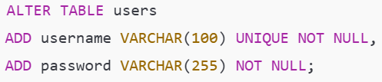
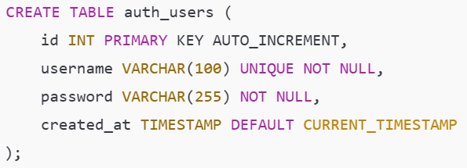
Steps for our Example Application
Changing the database:
Update the users table to include username and password fields:
OR Create a separate table for user authentication:

Slide 13
Steps for our Example Application
register.php:
Write the script that handles user registration by saving usernames and hashed passwords. (Check Canvas for the example script)
login.php:
Write the script that verifies a user's credentials and issues a session or token. (Check Canvas for the example script)
logout.php:
To log out a user, clear their session (Check Canvas for the example script)
IMPORTANT: Securing API Endpoints (Place it at the top of any script that requires authentication): Add authentication checks to protect sensitive endpoints like create.php, update.php, etc. (Check the next slide for an example script)

Slide 14
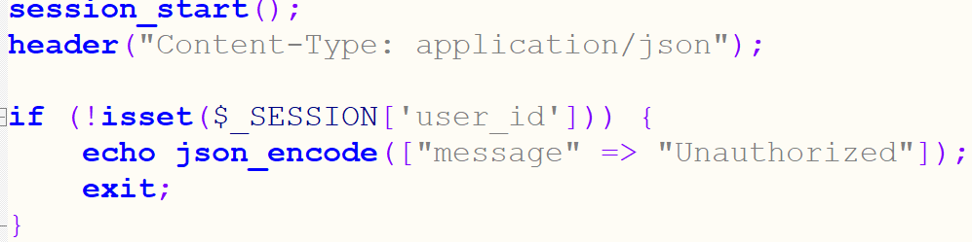
Sample Script to Secure Endpoints
Place the following scripts at the top of the API endpoint scripts like create.php, delete.php, and update.php
This is part of the session management and ensures that only authorized users can delete, update, and create users.

Slide 15
Implementing HTTPS

Slide 16
Step 1: Obtain an SSL/TLS Certificate
Referred to as a digital certificate generally
Based on the Public Key Infrastructure and X.509 standard
Usually issued by a trusted Certificate Authority (CA) like DigiCert, Let's Encrypt (Free CA), GoDaddy, GlobalSign, etc.
Contains the public key of the website being registered.

Slide 17
Step 1: Obtain an SSL/TLS Certificate
We use a self-signed certificate for local Web development:
Open the XAMPP Control Panel and go to the Shell.
Run the following command to create a self-signed certificate:
openssl req -x509 -nodes -days 365 -newkey rsa:2048 -keyout xampp.key -out xampp.crt
Provide details when prompted (e.g., country, state, organization).
Note: If the website is publicly accessible, use a tool like Certbot to obtain a certificate from Let’s Encrypt (CA)

Slide 18
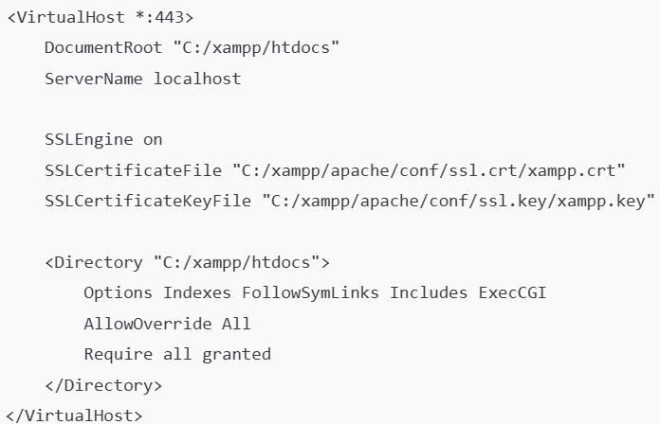
Step 2: Configure HTTPS in XAMPP
Navigate to your Apache configuration files in the XAMPP installation directory, typically: C:\xampp\apache\conf\extra
Open httpd-ssl.conf in a text editor. Check the settings.
This is an example. Your server might default to server.key and server.crt

Slide 19
Step 2: Configure HTTPS in XAMPP
Open the main Apache configuration file (httpd.conf) and ensure the following lines are uncommented:
LoadModule ssl_module modules/mod_ssl.so
Include conf/extra/httpd-ssl.conf

Slide 20
Step 3: Start Apache with SSL
Open the XAMPP Control Panel.
Stop and then restart Apache (If running)
Access your site using https://localhost.

Slide 21
Step 4: Update Frontend Code
Change all API URLs in your frontend code to use https://
Ensure JavaScript fetch calls handle self-signed certificates during local testing. (Got to https://localhost to check)
  Add the Self-Signed Certificate to Your Trusted Root Store (Preferred for Local Testing)
  Export the Certificate:
  Locate your .crt file (e.g., xampp.crt).
  Open the certificate file in a text editor. If generated by xampp it will be
  at: C:\xampp\apache\conf\ssl.crt\xampp.crt
Import the Certificate into Your Browser:
For Google Chrome: Open Settings > Privacy and Security > Security > Manage certificates.
Go to the Authorities tab.
  Click Import and select your .crt file. Trust the certificate for all purposes.
Can be server.crt by default

Slide 22
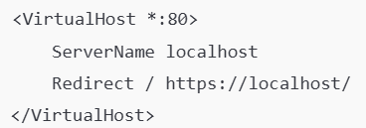
Step 5: Redirect HTTP to HTTPS
Open the httpd.conf file and add the following configuration
Save and restart Apache

Slide 23
Step 6: Test HTTPS
Visit your site at https://localhost.
If you see a warning about the certificate, this is expected with a self-signed certificate. You can bypass it for local testing.

Slide 24
Optional: Use phpMyAdmin with HTTPS
Open the config.inc.php file located in C:\xampp\phpMyAdmin.
Ensure the $cfg['PmaAbsoluteUri'] variable uses https://

Slide 25
Thank you
Questions???

